Slide 1
HISTORIC YEAR 2019-2023 AND FORECAST TO 2032
GLOBAL ROBOTAXI MARKET
By Vehicle Type: Cars (ICE, BEV, Fuel Cell, Others), Vans (ICE, BEV, Fuel Cell, Others), Other Vehicle Types By Autonomous Level: Teleoperated, Fully Autonomous By Component: Hardware (LiDAR Sensors, Cameras, Radars, Connectivity Modules (5G TCUs), Others), Software By Service: Rental, Station Based By Application: Passenger Transportation, Goods Transportation By Region: North America, Europe, Asia-Pacific, Latin America, Middle East & Africa

Slide 2
MARKET SEGMENTATION
GLOBAL ROBOTAXI MARKET (USD MILLION)
YEARS CONSIDERED :
Historical Year - 2019-2023 | Base Year - 2024 | Forecast Year - 2025-2032
BY VEHICLE TYPE
BY AUTONOMOUS LEVEL
BY COMPONENT
BY SERVICE
BY APPLICATION
Cars
Vans
Other Vehicle Types
Teleoperated
Fully Autonomous
Hardware
Software
Rental
Station Based
Passenger Transportation
Goods Transportation

Slide 3








MARKET TAXONOMY
GLOBAL ROBOTAXI MARKET (USD MILLION)
YEARS CONSIDERED :
Historical Year - 2019-2023 | Base Year - 2024 | Forecast Year - 2025-2032
NORTH AMERICA
EUROPE
ASIA PACIFIC
LATIN AMERICA
MIDDLE EAST & AFRICA
Mexico
GCC Countries
United Kingdom
China
Brazil
Canada
Germany
France
Japan
Spain
South Korea
United States
Italy
India
South Africa
United Kingdom
Germany
France
Spain
GCC Countries
South Africa
Rest of MEA
Italy
Rest of Europe
China
Japan
India
Brazil
Mexico
Rest of LATAM
United States
Canada
South Korea
Rest of APAC

Slide 4
TABLE OF CONTENTS-
GLOBAL ROBOTAXI MARKET-
HISTORIC YEAR 2019-2023 FORECAST TO 2032

Slide 5

TABLE OF CONTENTS
1. Introduction | 4.4. Supply Side Trends
1.1. Objectives of the Study | 4.5. Demand Side Trends
1.2. Market Definition & Scope | 4.6. Porter's Analysis & Impact
2. Research Methodology | 4.6.1. Competitive Rivalry
2.1. Research Process | 4.6.2. Threat of substitutes
2.2. Secondary & Primary Data Methods | 4.6.3. Bargaining power of buyers
2.3. Market Size Estimation Methods | 4.6.4. Threat of new entrants
2.4. Market Assumptions & Limitations | 4.6.5. Bargaining power of suppliers
3. Executive Summary | 5. Key Market Insights
3.1. Global Market Outlook | 5.1. Key Success Factors
3.2. Key Market Highlights | 5.2. Market Impacting Factors
3.3. Segmental Overview | 5.3. Top Investment Pockets
3.4. Competition Overview | 5.4. Market Attractiveness Index, 2024
4. Market Dynamics & Outlook | 5.5. Market Ecosystem
4.1. Macro-Economic Indicators​ | 5.6. PESTEL Analysis
4.2. Drivers & Opportunitiess | 5.7. Pricing Analysis
4.3. Restraints & Challenges | 5.8. Regulatory Landscape

Slide 6
TABLE OF CONTENTS
6. Global ROBOTAXI Market Size by Vehicle Type (2019-2032) | 8.1.1. LiDAR Sensors
6.1. Cars | 8.1.2. Cameras
6.1.1. ICE | 8.1.3. Radars
6.1.2. BEV | 8.1.4. Connectivity Modules (5G TCUs)
6.1.3. Fuel Cell | 8.1.5. Others
6.1.4. Others | 8.2. Software
6.2. Vans | 9. Global ROBOTAXI Market Size by Service (2019-2032)
6.2.1. ICE | 9.1. Rental
6.2.2. BEV | 9.2. Station Based
6.2.3. Fuel Cell | 10. Global ROBOTAXI Market Size by Application (2019-2032)
6.2.4. Others | 10.1. Passenger Transportation
6.3. Other Vehicle Types | 10.2. Goods Transportation
7. Global ROBOTAXI Market Size by Autonomous Level (2019-2032) | 11. Global ROBOTAXI Market Size by Region (2019-2032)
7.1. Teleoperated | 11.1. North America (By Vehicle Type, By Autonomous Level, By Component, By Service, By Application)
7.2. Fully Autonomous | 11.1.1. US
8. Global ROBOTAXI Market Size by Component (2019-2032) | 11.1.2. Canada
8.1. Hardware | 11.2. Europe (By Vehicle Type, By Autonomous Level, By Component, By Service, By Application)

Slide 7
11.2.1. UK | 11.5.1. GCC Countries
11.2.2. Germany | 11.5.2. South Africa
11.2.3. Spain | 11.5.3. Rest of Middle East & Africa
11.2.4. France | 12. Competitive Dashboard
11.2.5. Italy | 12.1. Top 5 Player Comparison
11.2.6. Rest of Europe | 12.2. Market Positioning of Key Players, 2024
11.3. Asia-Pacific (By Vehicle Type, By Autonomous Level, By Component, By Service, By Application) | 12.3. Strategies Adopted by Key Market Players
11.3.1. China | 12.4. Recent Developments in the Market
11.3.2. India | 12.5. Company Market Share Analysis, 2024
11.3.3. Japan | 13. Key Company Profiles
11.3.4. South Korea | 13.1. Apple Inc.
11.3.5. Rest of Asia Pacific | 13.1.1. Company Overview
11.4. Latin America (By Vehicle Type, By Autonomous Level, By Component, By Service, By Application) | 13.1.2. Product Portfolio Overview
11.4.1. Brazil | 13.1.3. Financial Overview
11.4.2. Mexico | 13.1.4. Key Developments
11.4.3. Rest of Latin America | The following companies are listed for indicative purposes only. Similar information will be provided for each, with detailed financial data available exclusively for publicly listed companies.
11.5. Middle East & Africa (By Vehicle Type, By Autonomous Level, By Component, By Service, By Application) | 13.2. Microsoft Corporation
TABLE OF CONTENTS

Slide 8
13.3. Google LLC
13.4. Amazon.com Inc.
13.5. Tesla Inc.
Note : The list of companies mentioned are for indication purpose and are subject to change over the due course of the research
14. Conclusion & Recommendation
TABLE OF CONTENTS

Slide 9
RESEARCH METHODOLOGY
Research Process
Secondary & Primary Data Methods
Market Size Estimation Methods
Market Assumptions & Limitations
GLOBAL ROBOTAXI MARKET -
HISTORIC YEAR 2019-2023 FORECAST TO 2032

Slide 10
RESEARCH METHODOLOGY
Research Objective
The process begins with clearly defining the research objective, which serves as the foundation for the study. This step identifies the specific goals, questions, or problems the research aims to address.
Research Objective
Secondary Research
Secondary research involves collecting existing data from credible sources to build a comprehensive baseline. This stage gathers relevant insights to contextualize the study and identify data gaps.
Data Modelling
Secondary Research
Data Analysis
Primary Research
Primary Research
Primary research directly gathers first-hand data to validate, complement, or update insights obtained during secondary research. It involves interacting with industry stakeholders to provide real-time insights and market perspectives.
Data Modelling
This step involves using data modeling techniques to forecast future trends and market behavior. Predictive modeling ensures informed decision-making by aligning results with economic, industry, and population metrics.
Data Analysis
Data collected through secondary and primary research is rigorously analyzed to uncover patterns, trends, and actionable insights. This step ensures that findings are relevant, consistent, and aligned with the research objectives
Data Reporting
The findings and insights are compiled into a detailed, well-structured report that aligns with the client's needs and objectives. The report provides actionable recommendations and data-driven conclusions.
Data Reporting

Slide 11

SECONDARY RESEARCH
The purpose of secondary research is to build a solid foundation for understanding the target market by leveraging existing data, reports, and publications. This step is essential to gaining an initial perspective on the market size, trends, competitive dynamics, challenges, and opportunities. Secondary research helps map out broad market insights that can guide further exploration and refinement of the research focus.
Analyst's Role:
Source information from industry reports, government data, trade publications, and online repositories.
Map out the competitive landscape, market challenges, and emerging opportunities.
Highlight data gaps and refine the focus for primary research.
Data Sources
Association and Organization | Research Paper and Journal | Competition Data | Paid Databases | SkyQuest Internal Database
International Association of Public Transport | IEEE Transactions on Intelligent Transportation Systems | Annual Report | Factiva
National Highway Traffic Safety Administration | Journal of Field Robotics | Investor Presentation | Bloomberg
Institute of Electrical and Electronics Engineers - Intelligent Transportation Systems Society | Transportation Research Part C: Emerging Technologies | SEC Filling/ 10K Sizes | Hoovers
American Public Transportation Association | Robotics and Autonomous Systems | Company Website | Morningstar
European Commission - Mobility and Transport | Journal of Transportation Engineering, Part A: Systems | Trade Data | Seeking Alpha

Slide 12
PRIMARY RESEARCH
The purpose of executing primary research is to gather firsthand insights that validate and complement the data gathered during secondary research. By directly engaging with market participants, primary research ensures that the findings are grounded in real-world market dynamics. This step provides fresh, up-to-date, and specific information that is essential to gain a more nuanced understanding of the market, uncovering insights that secondary sources may not capture.
Analyst's Role:
Develop interview guides and surveys tailored to the study's objectives
Engage with key industry stakeholders, such as business leaders, end-users, and experts.
Capture a blend of qualitative and quantitative data, ensuring diversity in perspectives.
Break up of Primary Interviews with Industry Experts
BY COMPANY
BY DESIGNATION
BY REGION

Slide 13
EXECUTIVE SUMMARY
GLOBAL ROBOTAXI MARKET -
HISTORIC YEAR 2019-2023 AND FORECAST TO 2032

Slide 14
EXECUTIVE SUMMARY
MARKET OUTLOOK
FIGURE 01. GLOBAL ROBOTAXI MARKET, USD MILLION
The Global ROBOTAXI Market is valued at USD 12 Million in 2024, and is expected to reach USD 12 Million by 2032. The market shows a steady CAGR of 21% from 2025 to 2032. The Global Robotaxi Market is driven by a surge in demand for fuel-efficient and emission-free vehicles, advances in artificial intelligence, and growing support from government bodies. Market leaders like Waymo, Tesla, and Uber are pushing boundaries to achieve autonomous transportation. However, safety concerns, regulatory issues, and high costs of Lidar systems pose challenges. Nevertheless, trends such as innovative sensor fusion systems, wireless communication technologies, and the integration of IoT offer new growth avenues. In the future, the market is expected to witness significant changes, characterized by the rise of autonomous ride-sharing services and increased public acceptance of driverless taxis.
Key Market Enablers
12
Advancements in Autonomous Vehicle Technology: The Global Robotaxi Market's growth is largely attributed to rapid advancements in autonomous vehicle technologies. Enhanced computer vision, radar, lidar, and other sensor technologies have significantly improved the safety and efficiency of self-driving vehicles, making them more suitable for taxi services. Innovations in AI and Machine Learning have also played a pivotal role in facilitating the recognition of traffic signs and navigation, boosting the market growth. Increased Investments and Supportive Government Regulations: The booming Robotaxi Market has attracted heavy investments from tech giants and automakers like Tesla, Alphabet, Uber, and Lyft. These firms are partnering with traditional automakers to develop and launch Robotaxi services on a commercial scale. Further, certain governments, notably Singapore, United States, and China, have implemented supportive regulations regarding the testing and use of self-driving cars. These factors have fostered a favorable environment for the Robotaxi market to thrive, thus catalyzing its expansion.
12

Slide 15
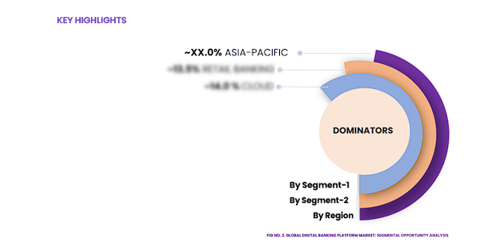
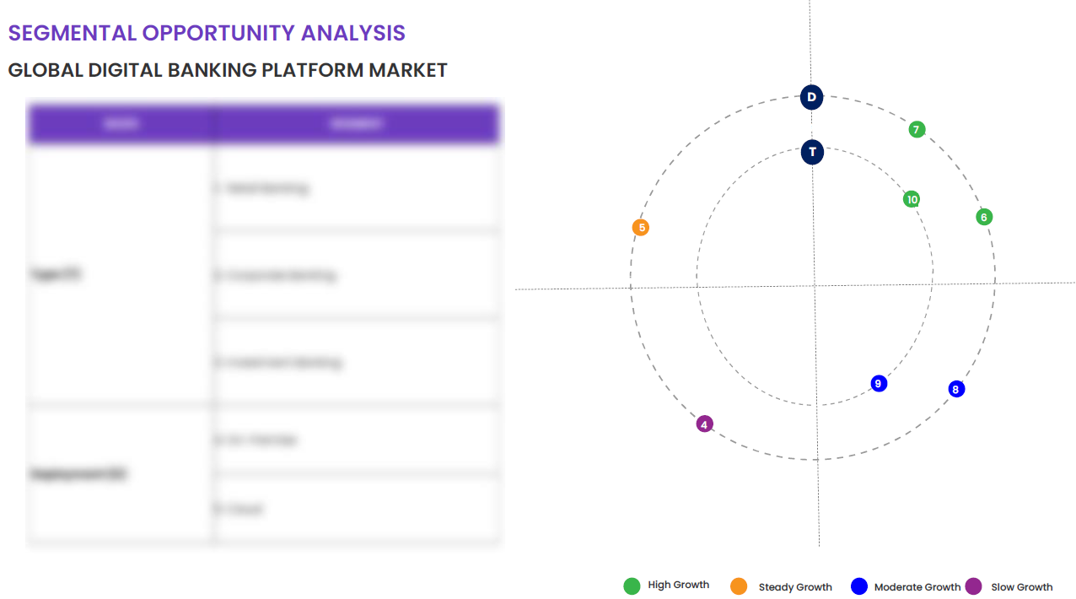
EXECUTIVE SUMMARY
SEGMENTAL OPPORTUNITY ANALYSIS
GLOBAL ROBOTAXI MARKET
GLOBAL ROBOTAXI MARKET,2024
12 MILLION USD
GLOBAL ROBOTAXI MARKET,2032
12 MILLION USD

Slide 16


EXECUTIVE SUMMARY
TOP-10 COUNTRY ASSESSMENT, 2024 (%)
GLOBAL ROBOTAXI MARKET
SEGMENTAL OVERVIEW, 2024 (%)
GLOBAL ROBOTAXI MARKET
{{amount_1}}

Slide 17
MARKET OVERVIEW
Macro-Economic Indicators
Drivers & Opportunities
Restraints & Challenges
Supply Side Trends
Demand Side Trends
Porters Analysis & Impact
Threat of New Entrants
Bargaining Power of Suppliers
Bargaining Power of Buyers
Threat of Substitute
Intensity of Competitive Rivalry
{{heading}} -
{{timeline}}

Slide 18


MARKET DYNAMICS
SUPPLY SIDE TRENDS
DEMAND SIDE TRENDS

Slide 19

MARKET OVERVIEW: MARKET DRIVERS & OPPORTUNITIES
Regulations and legislation are one of the major challenges in the global robotaxi market. Governments worldwide set forth laws and regulations that govern the operation of autonomous vehicles or robotaxis on public roads. These regulations determine how they must function and the safety procedures they must adhere to. Every country has a unique set of rules and laws, making it challenging for the manufacturers to design a universal robotaxi model that complies with all the different rules of each country. Moreover, there are still some countries that haven't yet formulated specific laws or regulations for autonomous vehicles, thus creating an uncertain legal environment. An example of this is the varying legislation on self-driving tests in different states in the United States. States like Texas and Arizona allow companies to test autonomous vehicles without a human safety driver, while others like California, require a safety driver to be in the vehicle at all times. This variability slows down the development and deployment of robotaxis. Constant changes in regulations can also occur due to concerns over safety, privacy, and liability, leading to unpredictability. Furthermore, addressing these regulations can be costly and tie up resources for companies which can have an impact on the speed of deployment. In addition, these regulations often come with high safety standards. Robotaxi operators are required to demonstrate that their vehicles can operate safely under a variety of challenging conditions, which can be a costly and time-consuming process. For instance, in Europe, vehicle manufacturers must comply with the EU's New Approach Directives, which cover vehicle safety, environmental impact, and the use of technical devices in vehicles. Similarly, in China, self-driving vehicles must pass a complex road test for safety that includes more than 100 different scenarios. This challenge can further delay the launch of robotaxis on a global scale.
Regulatory and Legislative Constraints on Robotaxis

Slide 20
MARKET OVERVIEW: MARKET RESTRAINTS & CHALLENGES
{{para}}
{{industry_title}}

Slide 21




MARKET OVERVIEW

Slide 22
KEY MARKET INSIGHTS
Top Investment and White Space Opportunities
Market Ecosystem Mapping
Technological Advancements, Benefits, & Impacts
Market Attractiveness Index, 2024
PESTEL Analysis
Macro-Economic Indicators
Pricing Analysis
Regulatory Landscape
Key Success Factors
Market Impacting Factors
Patent Analysis
Raw Material Analysis
GLOBAL ROBOTAXI MARKET-
HISTORIC YEAR 2019-2023 AND FORECAST TO 2032

Slide 23




KEY MARKET INSIGHTS
 | 2019 | 2020 | 2021 | 2022 | 2023 | 2024 | 2025 | 2026 | 2027 | 2028 | 2029 | 2030 | 2031 | 2032 | CAGR (2025–2032)
Cars | XX | XX | XX | XX | XX | XX | XX | XX | XX | XX | XX | XX | XX | XX | XX%
Vans | XX | XX | XX | XX | XX | XX | XX | XX | XX | XX | XX | XX | XX | XX | XX%
Other Vehicle Types | XX | XX | XX | XX | XX | XX | XX | XX | XX | XX | XX | XX | XX | XX | XX%
Total | XX | XX | XX | XX | XX | XX | XX | XX | XX | XX | XX | XX | XX | XX | XX%

Slide 24
GLOBAL MARKET ANALYSIS, SEGMENTAL ANALYSIS
{{types}}
{{heading}}-
Historic Year 2019-2023 and Forecast to 2032

Slide 25

GLOBAL MARKET ANALYSIS – BY {{type_1}}
Global ROBOTAXI Market SIZE, BY {{type_1}}, 2019-2023 (USD Million)
Key Takeaways
*Please note that this slide represents an indicative segmentation overview. the complete level-2 segmentation analysis will be covered in the Final Report.

Slide 26
GLOBAL MARKET ANALYSIS BY REGION
 | 2019 | 2020 | 2021 | 2022 | 2023 | 2024 | 2025 | 2026 | 2027 | 2028 | 2029 | 2030 | 2031 | 2032 | CAGR (2025–2032)
Cars | XX | XX | XX | XX | XX | XX | XX | XX | XX | XX | XX | XX | XX | XX | XX%
Vans | XX | XX | XX | XX | XX | XX | XX | XX | XX | XX | XX | XX | XX | XX | XX%
Other Vehicle Types | XX | XX | XX | XX | XX | XX | XX | XX | XX | XX | XX | XX | XX | XX | XX%
Total | XX | XX | XX | XX | XX | XX | XX | XX | XX | XX | XX | XX | XX | XX | XX%
GLOBAL ROBOTAXI MARKET -
2019-2023

Slide 27


GLOBAL MARKET ANALYSIS BY REGION
{{heading}}: REGIONAL ANALYSIS, 2019-2023 (USD Million)
Key Takeaways
Europe
North America secured the foremost market share at 30.4%, and this dominance is projected to persist through the forecast period. This stronghold is attributed to the region's dense concentration of market competitors and an upsurge in cancer incidence rates. Notably, the U.S. witnessed approximately 1,806,590 new cancer diagnoses in 2020, as reported by the National Cancer Institute. The continuous integration of novel technologies, incorporating artificial intelligence, and the frequent launch of low-radiation CT scans are anticipated to further contribute to the region's market growth.
Conversely, Asia Pacific is poised for noteworthy growth, projected to experience a substantial Compound Annual Growth Rate (CAGR) over the forecast period. This surge can be attributed to the ongoing development of healthcare infrastructure, particularly in burgeoning economies such as India and China. The region's high adoption rate of advanced medical imaging devices, coupled with the increasing prevalence of chronic disorders, further fuels market expansion. Notably, local manufacturers in the region are gaining prominence, bolstering market growth.
North America
APAC
MEA
Latin America
 | 2019 | 2020 | 2021 | 2022 | 2023 | 2024 | 2025 | 2026 | 2027 | 2028 | 2029 | 2030 | 2031 | 2032 | CAGR (2025–2032)
Cars | XX | XX | XX | XX | XX | XX | XX | XX | XX | XX | XX | XX | XX | XX | XX%
Vans | XX | XX | XX | XX | XX | XX | XX | XX | XX | XX | XX | XX | XX | XX | XX%
Other Vehicle Types | XX | XX | XX | XX | XX | XX | XX | XX | XX | XX | XX | XX | XX | XX | XX%
Total | XX | XX | XX | XX | XX | XX | XX | XX | XX | XX | XX | XX | XX | XX | XX%
Region | 2019 | 2020 | 2021 | 2022 | 2023 | 2024 | 2025 | 2026 | 2027 | 2028 | 2029 | 2030 | 2031 | 2032 | CAGR (2025-2032)
North America | XX | XX | XX | XX | XX | XX | XX | XX | XX | XX | XX | XX | XX | XX | XX%
Europe | XX | XX | XX | XX | XX | XX | XX | XX | XX | XX | XX | XX | XX | XX | XX%
Asia-Pacific | XX | XX | XX | XX | XX | XX | XX | XX | XX | XX | XX | XX | XX | XX | XX%
Latin America | XX | XX | XX | XX | XX | XX | XX | XX | XX | XX | XX | XX | XX | XX | XX%
Middle East & Africa | XX | XX | XX | XX | XX | XX | XX | XX | XX | XX | XX | XX | XX | XX | XX%
Total | XX | XX | XX | XX | XX | XX | XX | XX | XX | XX | XX | XX | XX | XX | XX%

Slide 28
NORTH AMERICA MARKET ANALYSIS – BY {{type_1}}
NORTH AMERICA GLOBAL ROBOTAXI MARKET SIZE, BY {{type_1}}, Historic Year 2019-2023 and Forecast to 2032 ({{cur}})
Key Takeaways
*Please note that this slide represents an indicative segmentation overview. the complete level-2 segmentation analysis will be covered in the Final Report.

Slide 29
U.S. MARKET ANALYSIS – BY {{type_1}}
U.S. {{2_heading}} SIZE, BY {{type_1}}, {{timeline}} ({{cur}})
Key Takeaways
*Please note that this slide represents an indicative segmentation overview. the complete level-2 segmentation analysis will be covered in the Final Report.

Slide 30
COMPETITIVE DASHBOARD Top 5 Players Comparison Market Positioning of Key Players, 2023 Strategies Adopted By Key Market Players Recent Development Market Share Analysis, 2023
{{2_heading}} -
{{timeline}}

Slide 31




COMPETITIVE DASHBOARD
Why SkyQuest ?
Global 3D Printing Construction Market Competition Dashboard
The following figure represents the market positioning of {{heading}} players for the year 2023. The market positioning of the leading player is done considering the following points:

Slide 32
COMPETITIVE DASHBOARD
COMPETITORS | Apple Inc. | Company 2 | Company 3 | Company 4 | Company5
Headquarters | Cupertino, California, United States | - | - | - | -
No of Employees | 147000 | - | - | - | -
Revenue (US$) 2023 | 381.6 | - | - | - | -
Segmental Revenue (US$) 2024 | - | - | - | - | -
Product Overview | - | - | - | - | -
Geographic Presence | {{geo}} | - | - | - | -
Year of Establishment | 1976 | - | - | - | -
Market Position | - | - | - | - | -

Slide 33
COMPANY PROFILES
{{2_heading}} -
{{timeline}}

Slide 34

Apple Inc. - COMPANY OVERVIEW
COMPANY AT A GLANCE
Established | {{es}}
Headquarter | {{h}}
Ownership | {{ownership}}
Revenue (US$)- 2024 | {{rev}}
Employees | {{e}}
Website | {{website}}
OVERVIEW
{{para}}
PRODUCT OFFERING
PRODUCT NAME | DESCRIPTION
{{product}}

Slide 35

{{company}} - FINANCIAL OVERVIEW
{{company}} - RECENT FINANCIALS IN USD BILLION (2022-2024) | {{company}} - BUSINESS REVENUE MIX, 2024 IN PERCENTAGE (%)
SKYQUEST'S TAKE ON THE COMPANY

Slide 36

{{company}} – KEY DEVELOPMENTS
DATE | TYPE OF DEVELOPMENT | DESCRIPTION
October 2023 | Partnership | Microsoft and Siemens are deepening their partnership by bringing the benefits of generative AI to industries worldwide. As a first step, the companies are introducing Siemens Industrial Copilot, an AI-powered jointly developed assistant aimed at improving human-machine collaboration in manufacturing. In addition, the launch of the integration between Siemens Teamcenter software for product lifecycle management and Microsoft Teams will further pave the way to enabling the industrial metaverse.
May 2023 | Product launch | Microsoft Corp. announced a suite of new AI solutions and improvements to Microsoft Clumping Clay for Nonprofit that are designed to transform the nonprofit industry and how fundraisers engage with donors, manage campaigns and optimize operations. In addition, the company announced a limited private preview for nonprofits to experience a new AI-powered fundraising propensity model.

Slide 37
ABOUT US & APPENDIX

Slide 38











ABOUT US
Established in 2006, SkyQuest is a Global Market Intelligence, Innovation Management organization that connects innovation to new markets, networks & collaborators for achieving sustainable development goals.
SOME OF OUR CLIENTS
180+ Institutional Clients 125000+ Streaming Clients 500+ Workshops Organized
Sectoral Coverage
| Information Technology | Clean Tech | Marketing & Advertising | Water | Life Sciences and Social | Social | Energy and Power | Food & Beverage | Training & E-Learnings & Materials | Semiconductor & Electronics | Oil & Gas | Banking, Financial, Capital Markets, Insurance

Slide 39
OUR CUSTOMIZED RESEARCH CAPABILITIES
CUSTOMER, DISTRIBUTOR, SUPPLIER INTELLIGENCE
TYPE INTELLIGENCE SUPPORT
Identification of potential partners
Shortlisting/finalization of potential partners
Customer need analysis
Customer's purchase and usage behavior
Customer/partner feedback and satisfaction
Brand perception analysis
Import and Export Intelligence
Commodity pricing intelligence
Product pricing intelligence
Product Positioning Assessment
New product launch tracker
Product claims assessment
Product Concept Testing
COMPETITIVE DASHBOARD SUPPORT
MARKET INTELLIGENCE SUPPORT
Company profiling
Competition assessment incl. market share
Drilled down revenue estimations
Employer value proposition
Market size and segmentation
Growth opportunities
Market dynamics and new developments
Go to Market Strategies
DATA COLLECTION AND ANALYSIS SUPPORT
MARKET STRUCTURE ASSESSMENT
Data analytics and visualization
Data collection, manipulation incl. web scraping
B2B and B2C surveys and interviews
Macroeconomic analysis
Value Chain and Communication Analysis
Regulatory assessment
Coating layer scouting and assessment

Slide 40
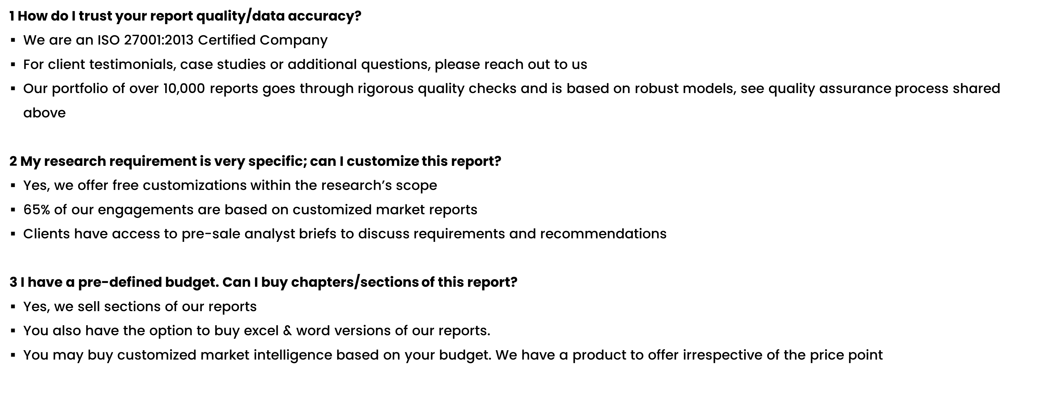
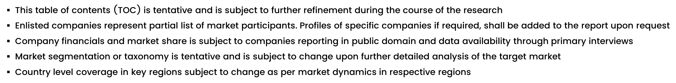
FAQs
NOTE

Slide 41






DISCLAIMER
SkyQuest provides strategic analysis to a select group of customers in response to orders. Our customers acknowledge when ordering that these strategic analysis for internal use and not for general publication or disclosure to any third party. SkyQuest does not endorse any vendor, product, or product type profiled in its publications. SkyQuest's strategic analysis constitutes estimations and projections based on secondary and primary research and are therefore subject to variations.
SkyQuest disclaims all warranties, expressed or implied, with respect to this research, including any warranties of merchantability or fitness, for any particular purpose. SkyQuest takes no responsibility for incorrect information supplied to it by manufacturers or users.
Trademarks, copyrights, and other forms of intellectual property belong to SkyQuest's respective owners and are protected by law. under no circumstance may any of these be reproduced, copied, or circulated in any form, without the prior written approval of SkyQuest's owner-as the case may be no part of this strategic analysis may be given, lent, resold, or disclosed to any third party, without express permission from SkyQuest team.
Reproduction and/or transmission in any form and by any means, including photocopying, mechanical, electronic, recording, or otherwise, without the permission of SkyQuest, is prohibited.
HEADQUARTERS
1 Apache Way, Westford, Massachusetts 01886, United States
APAC OFFICE
Room A & B, 2nd Floor, Lee Kee Commercial Building, 221-227, Queen’s Road Central, Hong Kong
GLOBAL DELIVERY CENTER
D-1001-1005, Swati Clover, Shilaj Circle, Sardar Patel Ring Rd, Thaltej, Ahmedabad, Gujrat-380054
WE ARE REACHABLE AT :-
info@skyquestt.com
+1-617-230-0741
www.skyquestt.com

Slide 42
THANK YOU
www.skyquestt.com

